Slide 1
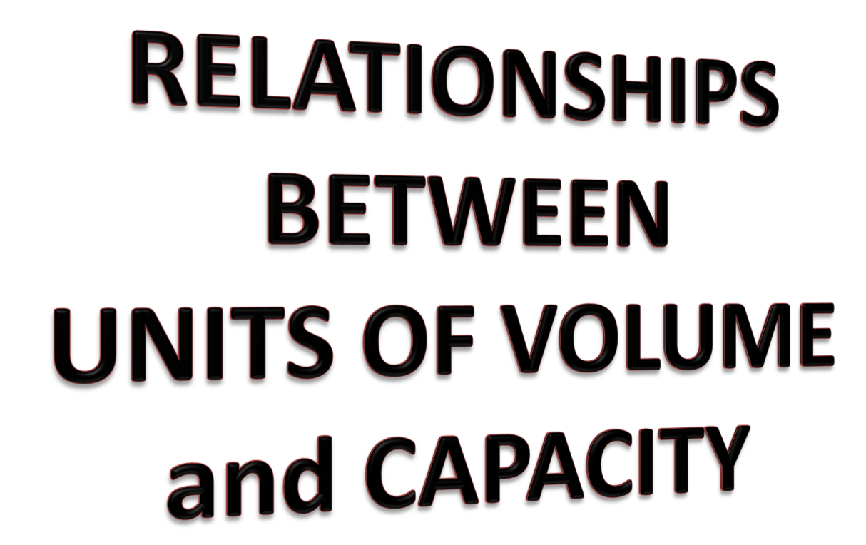

Slide 2
24
7
30
Date
Units of Measurement
EQ – What relationship exists between Volume and Capacity units of measurement?
What is Capacity?
Capacity is the amount that a container will hold.
What is Volume?
Volume is the amount that a container will hold
in cubic units.
5
Notes:
Input

Slide 3
Special conversions you need to know
Length measure
1-dimension
Area/TSA measure
2-dimensions
Volume measure
3-dimensions
100cm = 1m
10 000cm² = 1m²
1 000 000cm³ = 1m³
1000mm = 1m
1 000 000mm² = 1m²
10⁹ mm³ = 1m³
10mm = 1cm
100mm² = 1cm²
1000mm³ = 1cm³
1000m = 1km
1 hectare = 10000m²
CAPACITY
1 litre = 1000cm³
1m³ = 1000 litres
1cm³ = 1 mL

Slide 4
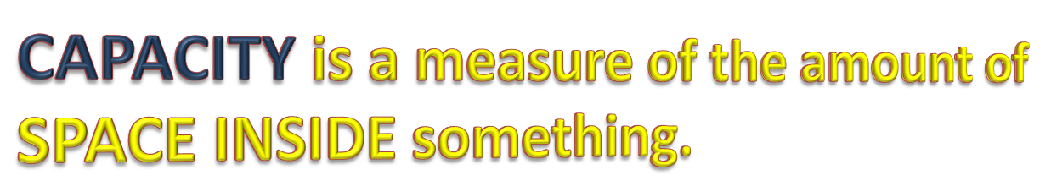
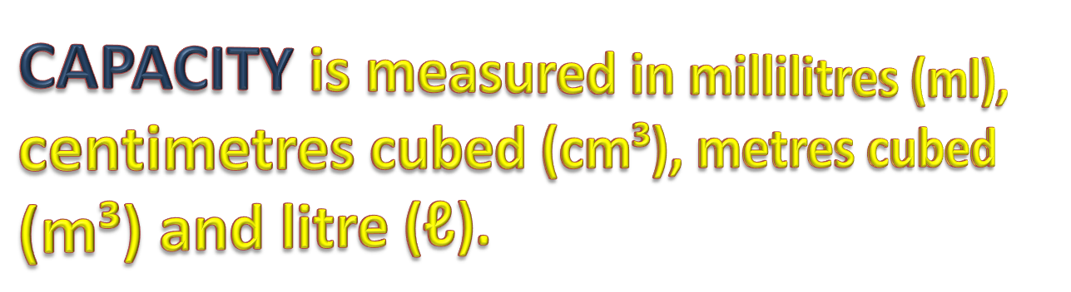
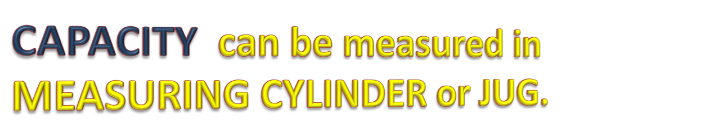


Slide 5
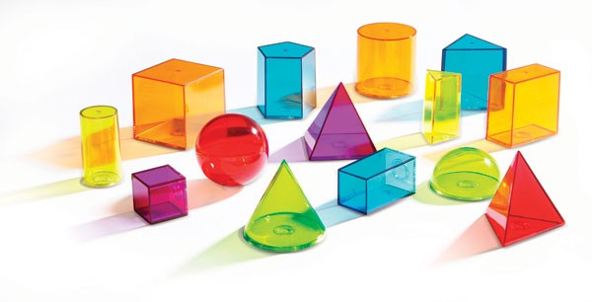


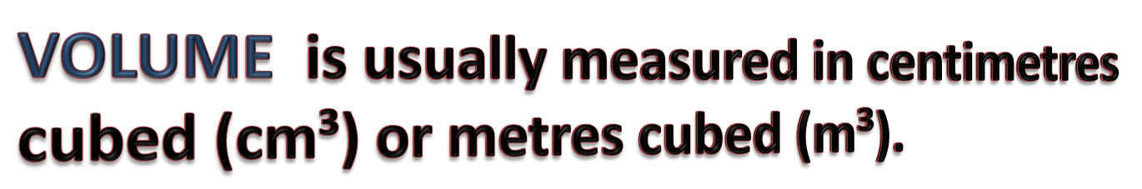


Slide 6
Conversion of units
1cm – 10mm
1m – 100cm
1km – 1000m

Slide 7
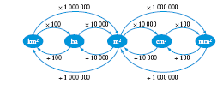
Conversions of Units
1 cm2 = 10 mm x 10 mm =100 mm2
1 m2 = 100 cm x 100 cm = 10 000 cm2
1 m2 = 1000 mm x 1000 mm = 1 000 000 mm2
1 ha = 100 m x 100 m = 10 000 m2
1 km2 = 100 ha

Slide 8
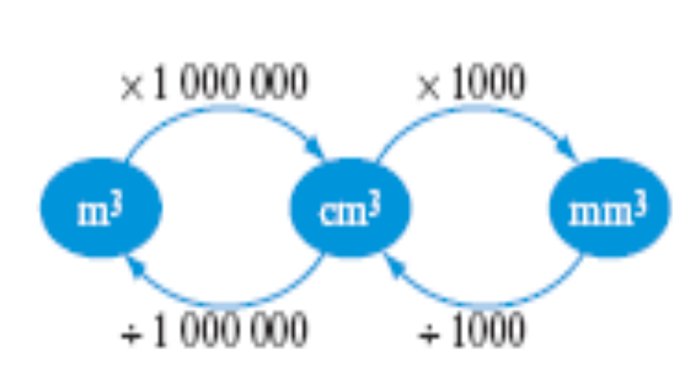
What about when cubic units?
1 cm³
= 1cm x 1cm x 1cm
= 10 mm × 10 mm × 10 mm
= 1000 mm³
1 m³
= 1m x 1m x 1m
= 100 cm × 100 cm × 100 cm
= 1 000 000 cm³

Slide 9

Capacity
Volume - The volume of a three-dimensional figure is the amount of space within it.
Measured in Units Cubed (e.g. cm3)
Volume and capacity are related.
Capacity is the amount of material (usually liquid) that a container can hold.
Capacity is measured in millilitres, litres and kilolitres.

Slide 10
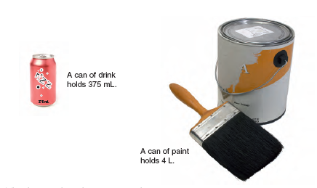
Examples of Capacity

Slide 11
How does Volume relate to Capacity?
1000 mL = 1 L
1000 L = 1 kL
1 cm³ = 1 mL
1,000cm³ = 1000ml = 1L
1 m³ = 1000 L = 1 kL

Slide 12
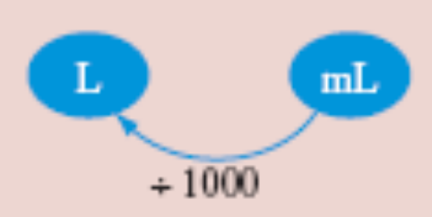
Examples
Convert 1800 mL to L
1800ml = 1800/1000
      = 1.8L
2.3 m3 to L 1m3 = 1000L (1kL)
2.3m3 = 2.3kL
      = 2300L

Slide 13
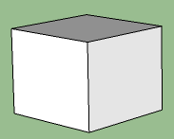
Capacity
Length = 5.53cm
Find the Capacity of this cube
Length = 5.53cm
V = Ah
= (5.53 x 5.53) x 5.53
= 169.11cm3 (1cm3 = 1ml)
Capacity = 169.11ml

Slide 14
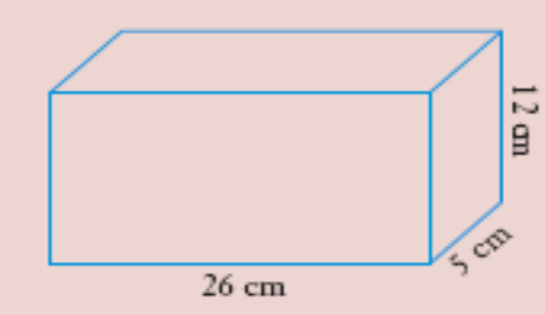
Example
Find the capacity of this rectangular prism.
Solution
Volume = Ah
= (26 x 12) x5
= 312 × 5
= 1560 cm3 (1cm3 = 1mL)
Capacity = 1560 mL or 1.56 L (1000mL = 1L)

Slide 15
Your Turn- Task 2
Work through the exercises p 31- 33 MAWA Essential Mathematics

